Slide 1

SEARCHING FOR SCIENCE

Slide 2
The Research Question
Is there a distinct difference between scientific search results in different languages?
Notes:
השאלת הכללית שלנו: האם קיים הבדל באיכות המידע בין כל שפה? על מנת לבחון זאת אנו נרצה לשאול עוד שאלת מחקר. האם יש פיטצ'רים משמעותים יותר עבור מידע איכותי? האם בכלל קיים הבדל בפיצ'רים הללו בין השפות?

Slide 3
Motivation
The general belief is that the internet has made it easier for people to get quality information with a few clicks. But, this is not necessarily the case.
As you may know, education is one of the important fields in every country. And yet there is a distinct knowledge gap among students worldwide. We believe that our research might help tackle this problem from an interesting angle.
Notes:
Previous work has demonstrated that democratic societies that are scientifically literate make equitable choices regarding science-related policy issues (European Commission, 1995; Rudolph and Horibe, 2016). Thus, effective communication of science and science literacy are socioeconomically imperative for all societies. Considering basic science is primarily funded by government funds in many countries (OECD, 2015), access to and understanding of science is also a right for tax-paying citizens around the world.

Slide 4
So what has already been done in this field?

Slide 5
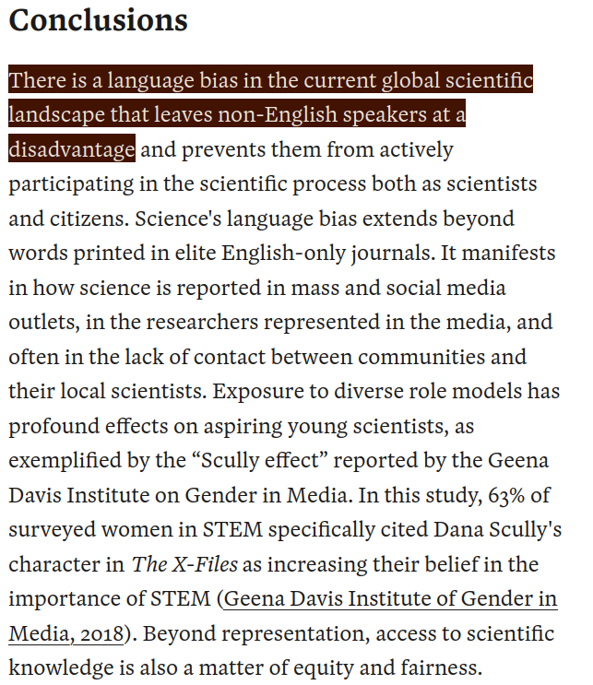
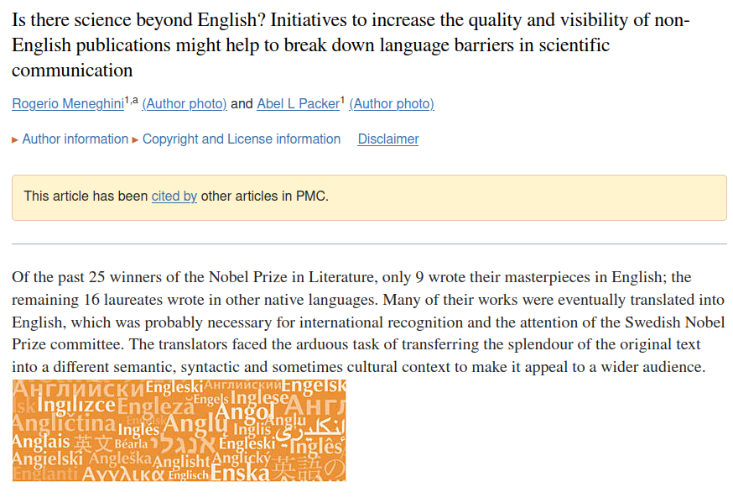

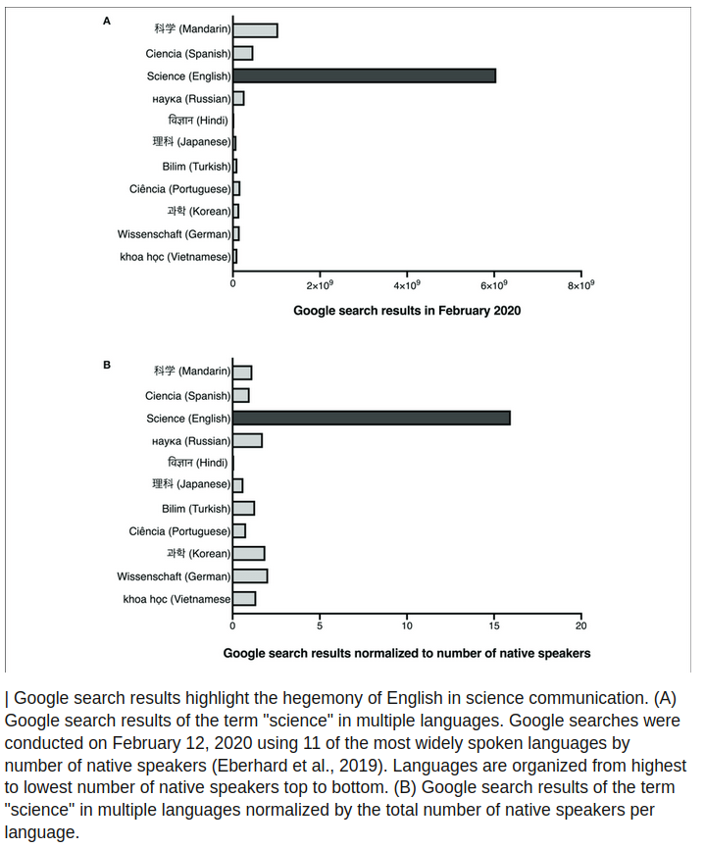

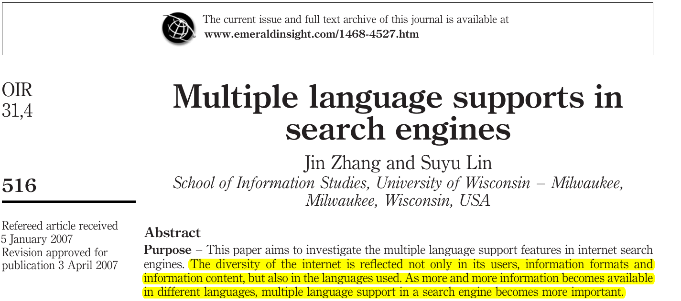
Notes:
ואכן מהיות כך שזה נושא חשוב נעשו כמה מחקרים בתחום. בהתבסס על המחקר שהתבצע באוניברסיטה ווינסקונסין אנו יודעים שהתמיכה בשפות מרובות בצורה הכי טובה היא במנוע החיפוש גוגל ולכן נשתמש בו בצורה בלעדית עבור השאלת מחקר הזאת. במחקר אחר שבוצע בגורנל פרונטירס נמצא שאכן יש ביאס עבור השפה אנגלית אך המחקר הזה בוצע מכיוון אחר ממה שאנחנו חיפשנו והוא לא בחן איכות הוא בכן כמות כמו שניתן לראות באחד הממצאים שלהם עבור כמות תוצאות בגוגל כמו שניתן לראות בגרף המוצג.
אך לבסוף לא הצלחנו למצוא מחקר אשר מגדיר מה הוא מידע איכותי. נוסף על כך לא מצאנו מחקר אשר בנה על ה יו איי של העמוד חיפוש עצמו ( כאשר נזכור לעצמנו שגוגל הוא המנוע חיפוש הטוב ביותר ) ולכן נאלצנו לבנות את כל המחקר מאפס בלי התבססות על תוצאות קודמות ונאלצנו להגדיר הכל מחדש.

Slide 6
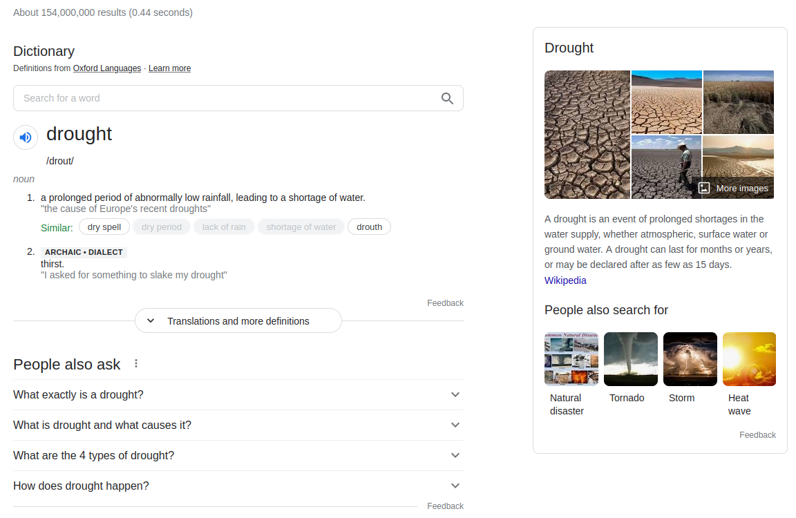
Our Innovation
Our approach is to test the difference between the UI elements on the same search term across different languages.
We assumed that the google “attention engineers” have spent a lot of time crafting the smoothest and easiest information gathering experience.
You might see it as a:
Summary box on the side
Dictionary definition
People also ask box
Related searches
Videos
etc.
Notes:
החידוש שלנו הוא בעצם הכל. אנחנו הולכים לבחון כל עמוד סינטיפיק לפי היו איי שלו.

Slide 7
Data Overview
Our Data consists of 120 html pages provided by Nir Grinberg. each html page contains only the front page of the google search for the specific scientific term in each language (Hebrew, English, Arabic, Russian)
Let's look at one of the html pages

Slide 8
Data gathering methods

Slide 9
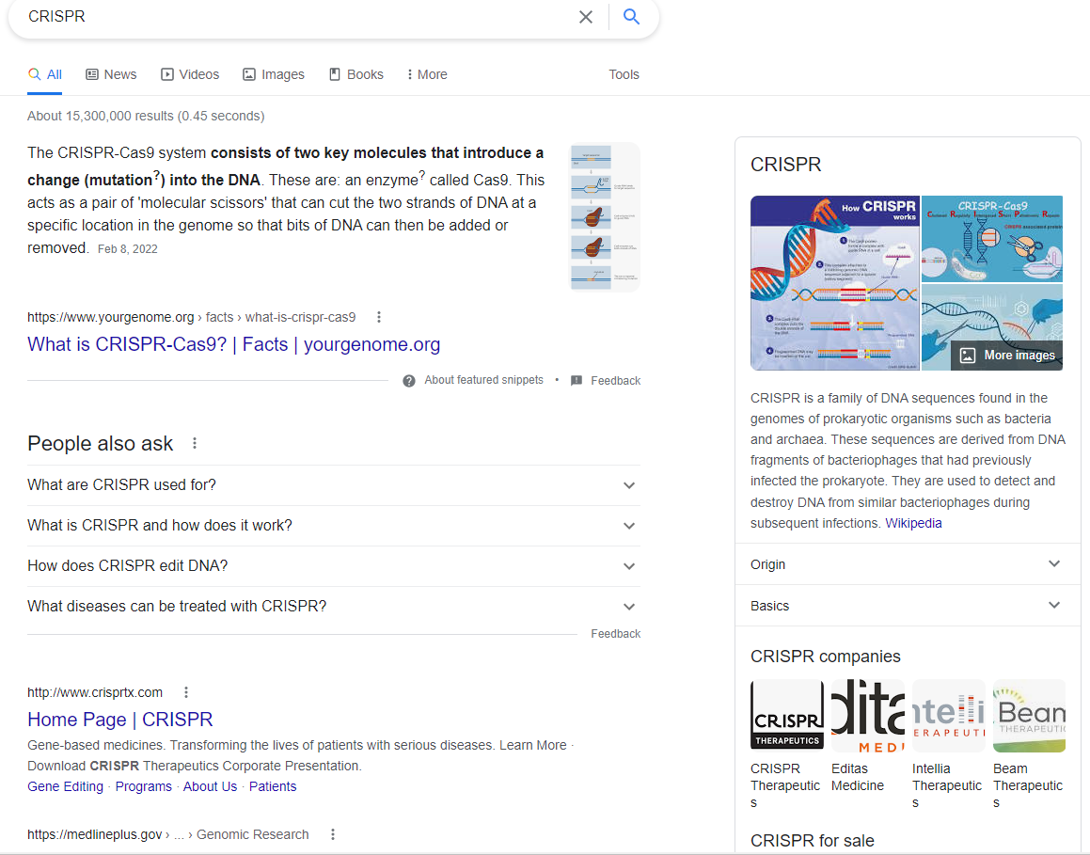
Can we really gather data from this page?? Well it's not so simple so let's dive deeper into understanding our data

Slide 10
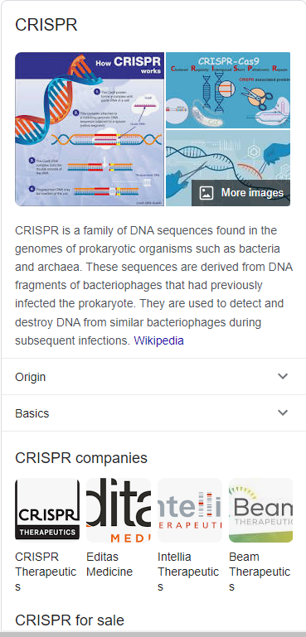
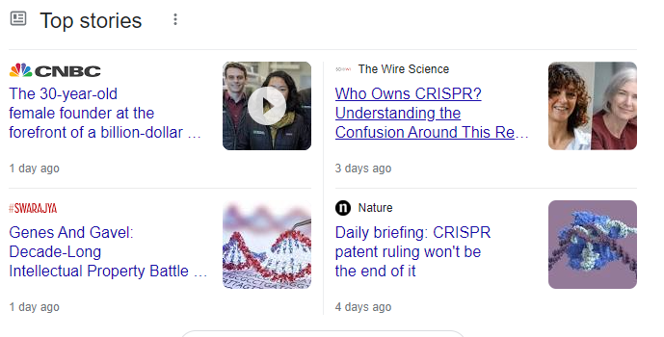
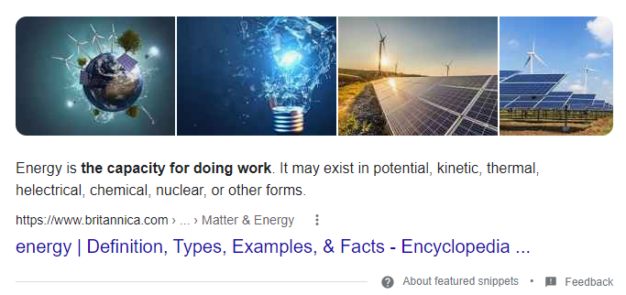
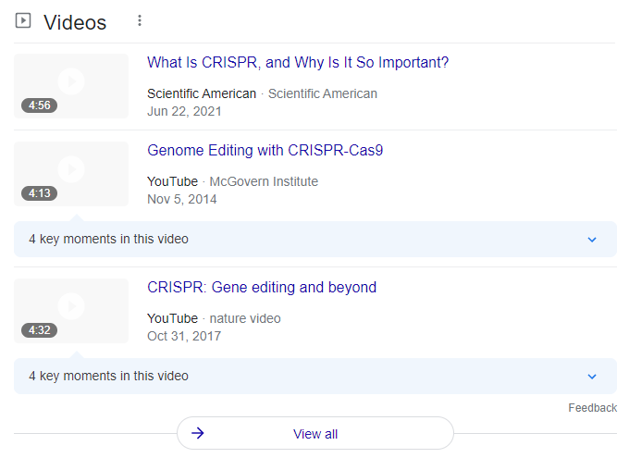
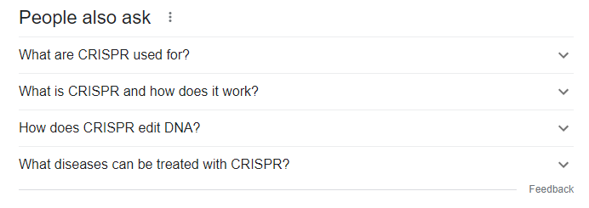
After realising there was no current research about what makes data to be considered quality data we tried to decide ourselves what are the features that make the search page better.
After consulting with UX designer we came to a conclusion that Google knows best what makes the data better and we tried to see what exactly catches our eye and interest in each google page and we came to the conclusion that:
1) Google widget
2) Recommended videos
3) Dictionary Widget
4) People also ask widget
5) Top stories widget

Slide 11
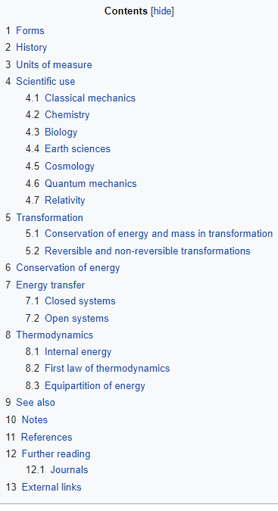
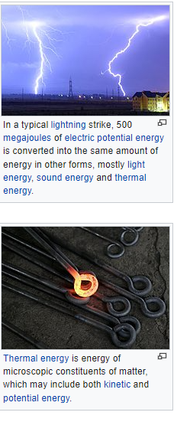
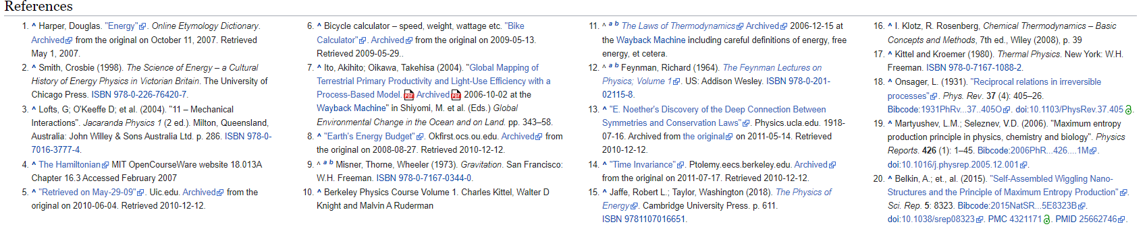
Now you probably ask yourself, is that really enough?
And you are right! It’s not. So is there another popular search engine for scientific terms? That right, Wikipedia
So we decided to scrape all of the links in each google page and extract the wikipedia page and gather the:
Number of references
Number of continents in the Table of contents
Number of pictures in each wiki page

Slide 12
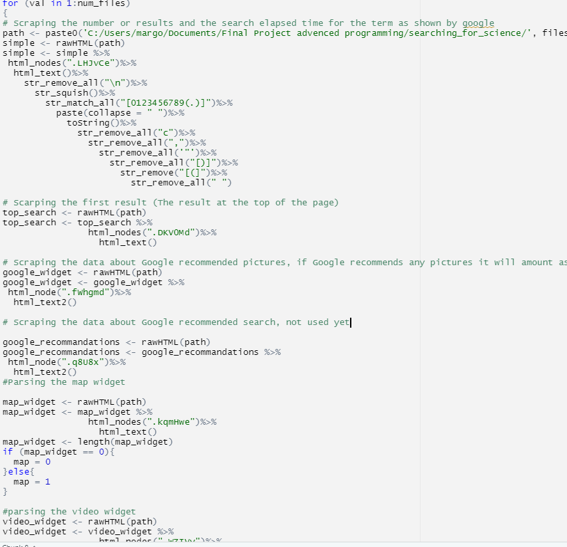
we didn't manage to find any scraping api to meet our searching standard and therefore with did everything from scratch
We encourage everyone to check our github at the end of the presentation to see the Data gathering work we have done which took most of our time

Slide 13
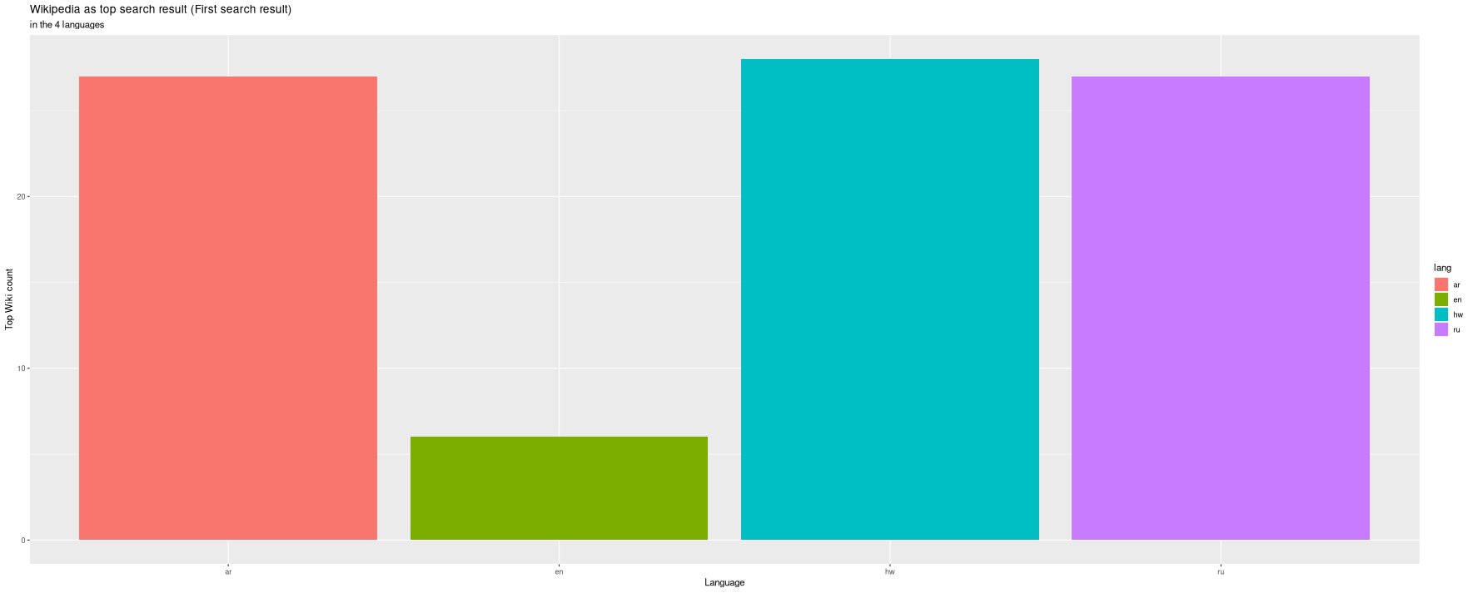
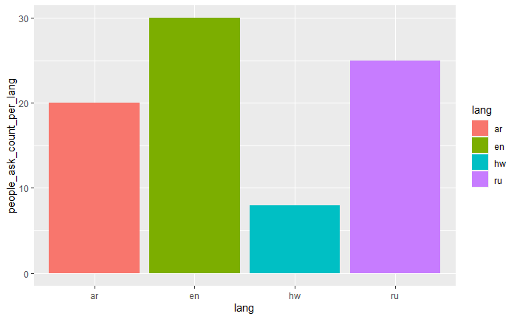
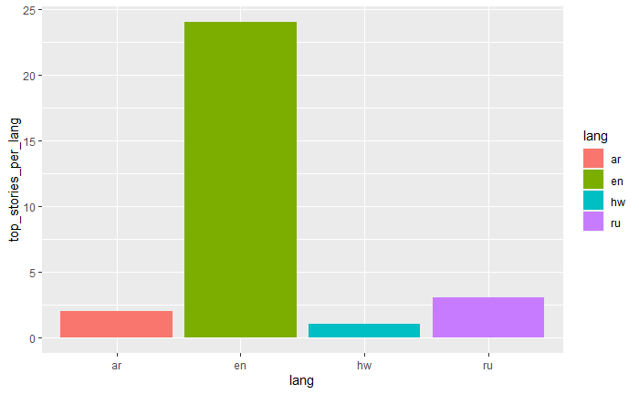
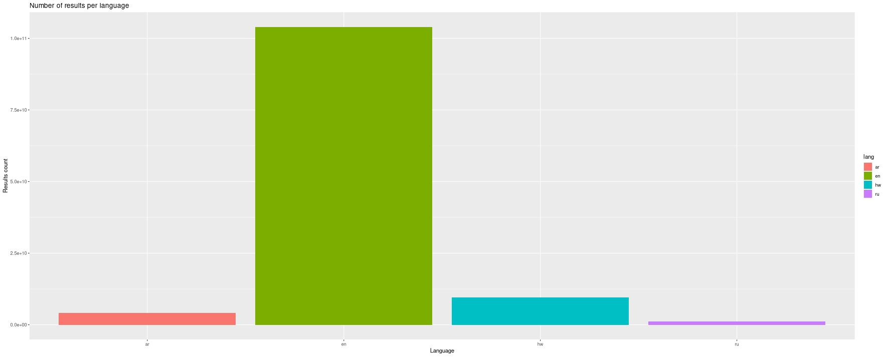
Lets see the differences between the pages per language

Slide 14
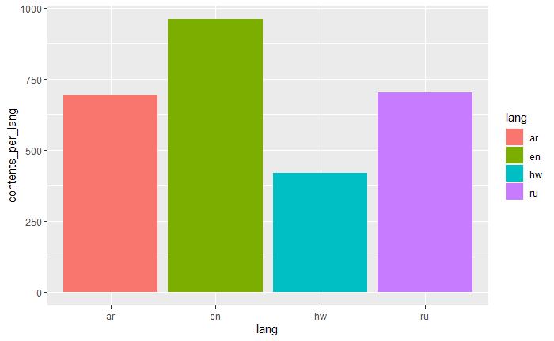
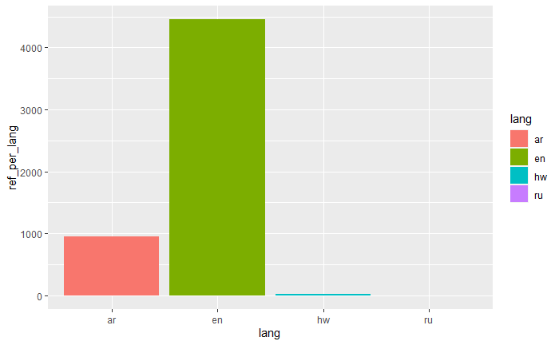
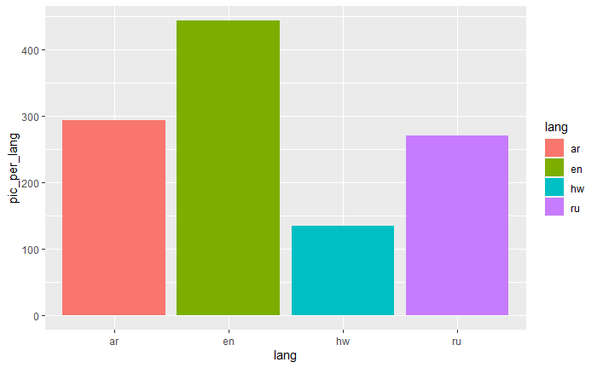

Lets see the differences between the pages per language

Slide 15
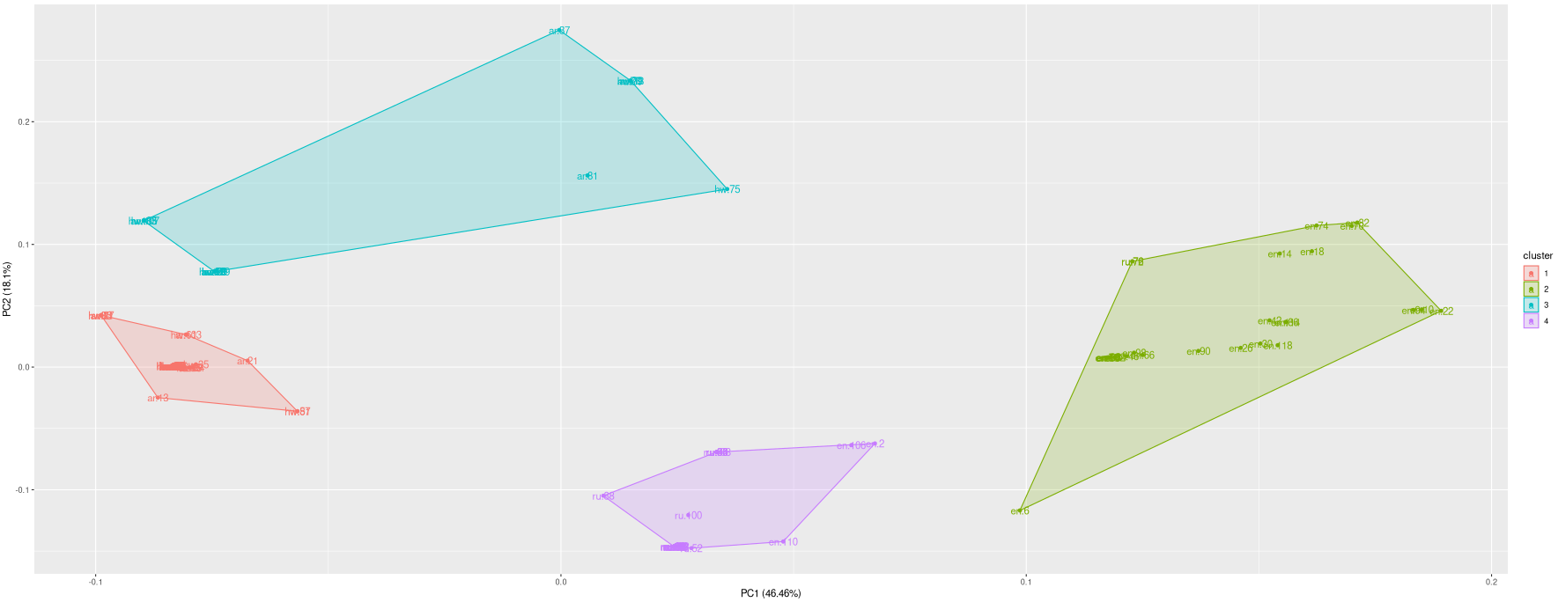
Method 1 - Kmeans Clustering
Since there are a lot of differences, and we don't have a dependant variable, fitting a K-means model seems like the go to move in order understand if there is a distinct difference between the data columns.

Slide 16
Lets Go Deeper

Slide 17
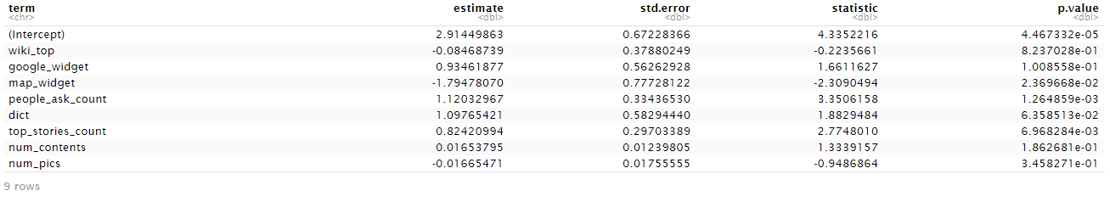
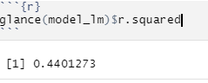
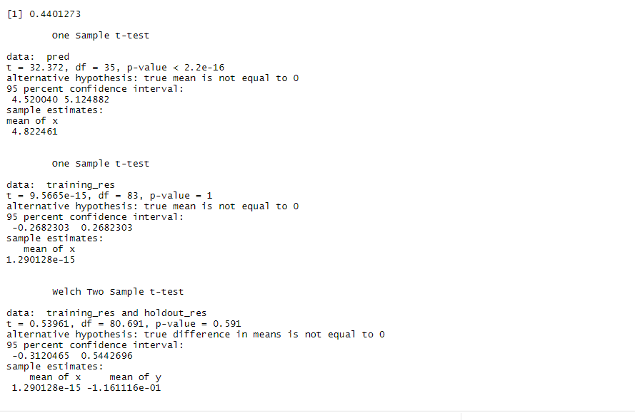
Method 2 - Linear regression
So we know there is a difference, lets quantify it!
We rated all of the search pages based on the UI elements and general feel in order to get a dependent variable and fit a regression model that predicts the score based on few of the extracted features.

Slide 18
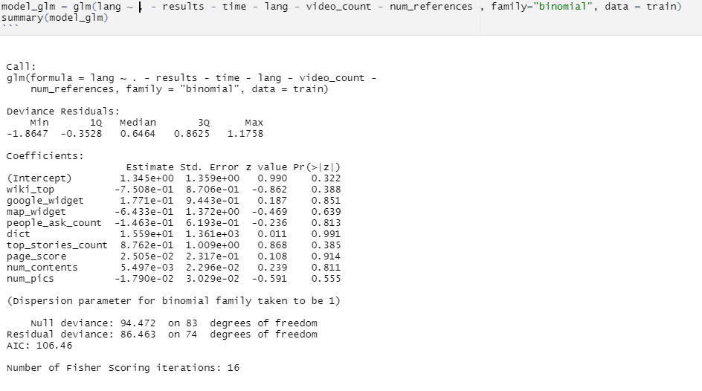
Method 3 - Logistic regression
Now that we know the most impactful features on the score from the previous model, we can fit a logistic regression model which should predict the language based on the features.

Slide 19
Findings
As we can see, there is a distinct difference between the different search terms across languages as found by the K-means model.
As the Kmeans algorithm is unsupervised we only used him to see if there is any difference in the data but we didn’t evaluate the model in any way because its not part of our research question. As we know from the previous finding in the frontiers research we know that there is a major bias towards English.

Slide 20
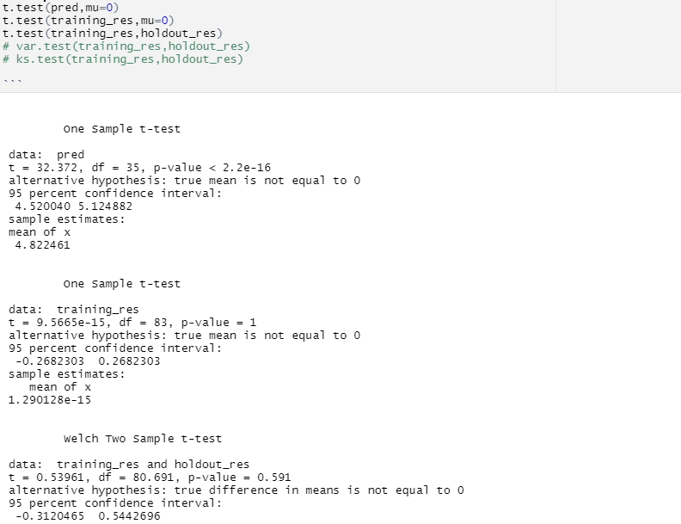
Findings
Furthermore, we saw that we can rate the search page fair enough based on the different page components, although the model isn’t great in the humanitarian field and Rsquared more than 0.4 counts as enough.
Also after applying the t-test method on each data set ( train set and test set) and applying the welch’s t-test. And applying the F-test we concluded that the model is fair enough.

Slide 21
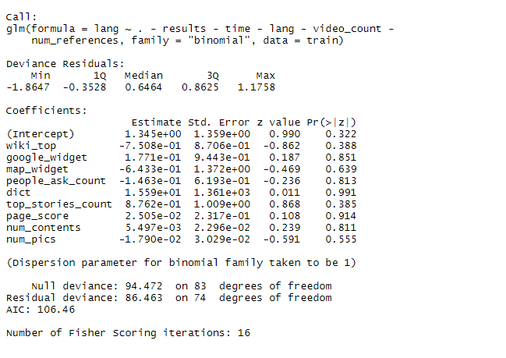
Findings
But unfortunately we did not come up with a proper way of predicting the search language based on these components. After applying the logistic regression models and applying what we have learned in class we couldn’t find a proper way to find the difference between the languages and connect it to the page rank. And that’s exactly the reason we decided to start from the features and maybe find difference in the languages base on the features that were most impactful on the page score.
Our model for predicting the language gave us an AUC score of 0.630 which is close to random and not good for our case.

Slide 22

Questions?

Slide 23
Github:
https://github.com/DanielKuz

